Slide 1

Data warehouse design Assignment 1 Group 2
Manaswini Reddy Pulakurthi
Sheetal Aggarwal
Arshad Jamal
Deepesh Puthran
Siva Prasad Sahoo

Slide 2
Objective
The objective of this exercise is to design Dimensional models for the Stock Market and the online Hotel booking portal scenarios and answer some interesting business questions based on the design.

Slide 3
Contents
Objective
Stock Market : Assumptions
Stock Market : Dimensional Model
Stock Market : Facts Tables
Stock Market : Dimensions Tables
Stock Market : Queries
Online Hotel booking Portal : Assumptions
Online Hotel booking Portal database : ER Diagram
Online Hotel booking Portal : Dimensional Model
Online Hotel booking Portal : Facts Tables
Online Hotel booking Portal : Dimensions Tables
Online Hotel booking Portal : Queries

Slide 4
Stock Market : Assumptions
Stock’s low, high, open and close prices are recorded in one currency.
Granularity is one of the important aspects as we aim to check for stock fluctuations. The daily seasonality of stock prices is considered.
Once the data is recorded, no updates will be made to past data.
The event has an impact on stock prices and we have categorized event type as a Natural disaster and Unnatural Disasters.

Slide 5
STOCK MARKET: Dimensional Model

Slide 6
STOCK MARKET : FACTS TABLES
STOCK_FACT:
TICKER_SYMBOL, DATE_ID, EVENT_ID, OPEN, HIGH, LOW, CLOSE, VOLUME.
TRANSACTION_FACT:
TRASACTION_ID, CUSTOMER_ID, DATE_ID, TICKER_SYMBOL, EXCHANGE_ID, SHARES_SOLD, SHARES_PURCHASED, TRANSACTION_SK.

Slide 7
STOCK MARKET: Dimensional TABLES
DIM_DATE: DATE_ID, TIME_ID, THE_DATE, YEAR, QUARTER_NUMBER_CALENDER, QUARTER, MONTH_NUMBER_CALENDER, MONTH, WEEK_OF_YEAR, WEEK_OF_MONTH, DAY_OF_YEAR, DAY_OF_MONTH, DAY_OF_WEEK_NUMBER, DAY_OF_WEEK, IS_WEEKDAY, NH_SEASON, SH_SEASON, IS_THIS_YEAR, IS_THIS_YEAR, IS_NEXT_YEAR, IS_THIS_QUARTER, IS_LAST_QUARTER, IS_THIS_MONTH, IS_NEXT_MONTH, IS_THIS_WEEK, IS_LAST_WEEK, FISCAL_YEAR, FISCAL_MONTH, FISCAL_QUARTER, HOLIDAY_INDICATOR, IS_TODAY, IS_TOMORROW, IS_YESTERDAY.
DIM_TIME: TIME_ID, THE_TIME_24, THE_TIME_12, HOUR_24, HOUR_12, MINUTE, SECOND, MERIDIEN.
DIM_EXCHANGE: EXCHANGE_ID, TICKER_SYMBOL, DATE_ID, EXCHANGE_NAME.

Slide 8
STOCK MARKET : DIMENSIONS TABLES
DIM_CUSTOMER: CUSTOMER_ID, DATE_ID, CUSTOMER_FNAME, CUSTOMER_LNAME, SHARE_QUANTITY, STREET, STATE, ZIP, PHONE.
DIM_STOCK: COMPANY_ID, TICKER_SYMBOL, GICS_SECTOR, DATE_REMOVED, DATE_ADDED, NOTE.

Slide 9
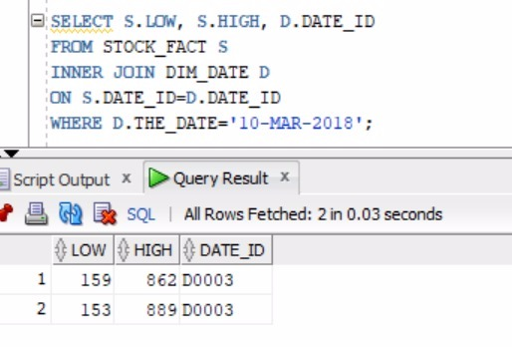
STOCK MARKET : Queries
Query 1: Highest and lowest stock value on a particular date.

Slide 10
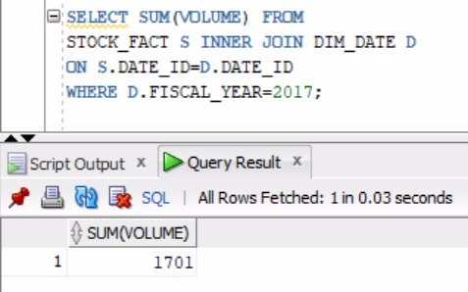
STOCK MARKET : Queries
Query 2: Volume of stock traded in a fiscal year.

Slide 11
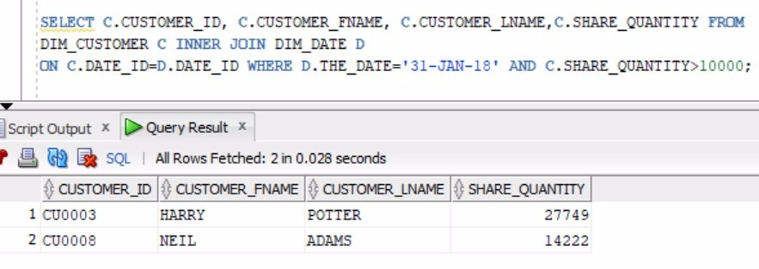
STOCK MARKET : Queries
Query 3: Customers having share quantity greater than 10,000 on 31 Jan 2018.

Slide 12
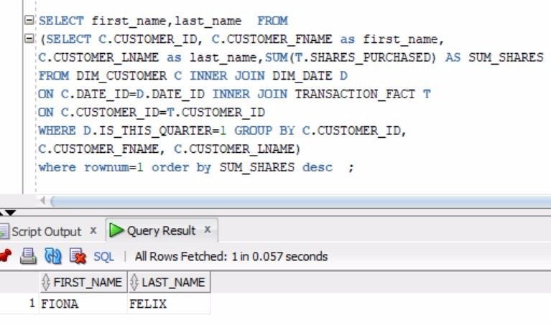
STOCK MARKET : Queries
Query 4: Top customer of Quarter 1.

Slide 13
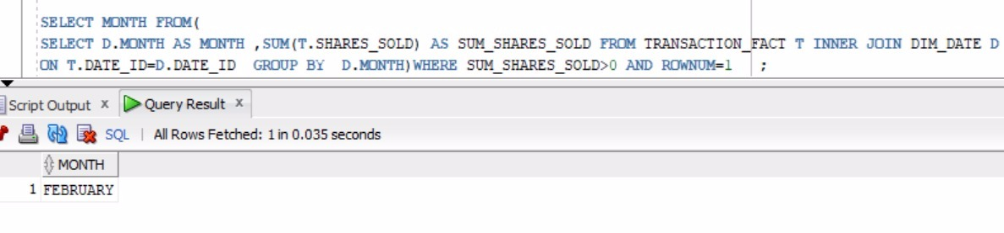
STOCK MARKET : Queries
Query 5: Month which has highest sale.

Slide 14
ONLINE Hotel booking PORTAL assumptions
The attributes considered as part of the facts and the dimensions table are not exhaustive unlike in the real online Hotel booking portal use cases.
The number of results displayed as part of the queries are less as we have generated 50 rows of data for each table which is just for the illustration purpose to simulate the business use cases.

Slide 15
ONLINE Hotel booking PORTAL database : ER Diagram

Slide 16
Online Hotel booking Portal : Dimensional Model

Slide 17
ONLINE Hotel booking PORTAL: FACTS TABLES
FACT_BOOKING:
BOOKING_KEY, DATE_KEY, PROPERTY_KEY, USER_KEY, DATE_CHECKOUT_KEY, PAYMENT_KEY, CURRENCY, PRICE, TOTAL_AMT, DATE_BOOK_KEY.
FACT_REVIEW:
REVIEW_KEY, PROPERTY_KEY, REVIEW_ID, REVIEW_DATE, RATING, REVIEW_DESCRIPTION.

Slide 18
ONLINE Hotel booking PORTAL: DIMENSIONS TABLES
DIM_USER: USER_KEY, USER_ID, CONTACT_NO, EMAIL_ID, LNAME, FNAME, PASSWORD, SSN, BGC_FLAG, DOB.
DIM_PAYMENT:PAYMENT_KEY, PAYMENT_ID, CARD_ID, CARD_TYPE, NAME_ON_CARD, EXPIRY_MONTH, EXPIRY_YEAR, CVV.
DIM_PROPERTY:PROPERTY_KEY, CHECKIN_DATE_KEY, PROPERTY_ID, PROPERTY_NAME, PROPERTY_DESC, GUEST_COUNT_MAX, NO_OF_BATHROOM, NO_OF_BEDROOM, STREET_ADDRESS, CITY, STATE, COUNTRY, ZIPCODE.
DIM_DATE_CHECKOUT:DATE_CHECKOUT_KEY, MONTH, DAY, YEAR.
DIM_DATE_BOOKING:DATE_BOOK_KEY, MONTH, DAY, YEAR.

Slide 19
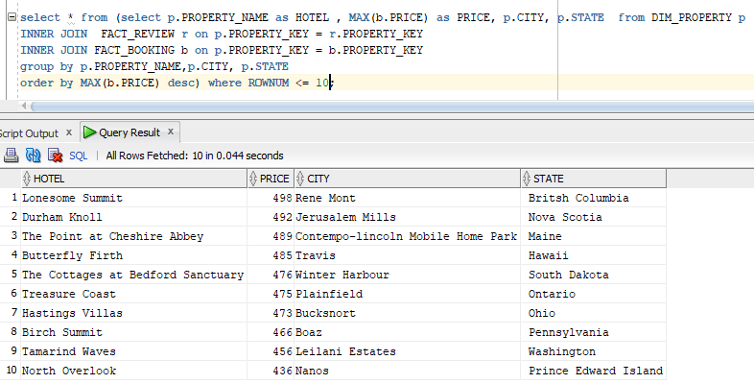
ONLINE Hotel booking PORTAL: Queries
Query 1: Names of the top 10 most expensive hotels with the cities and the states to which it belongs.

Slide 20
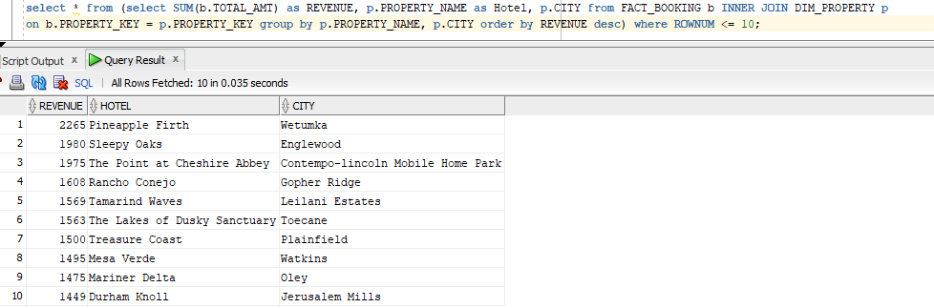
ONLINE Hotel booking PORTAL: Queries
Query 2: Top 10 Hotels with respect to the total revenue generated.

Slide 21
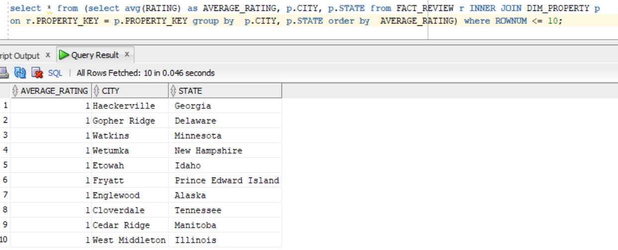
ONLINE Hotel booking PORTAL: Queries
Query 3: Top 10 cities containing worst hotel with respect to the ratings of the customers and state in which they belong.

Slide 22
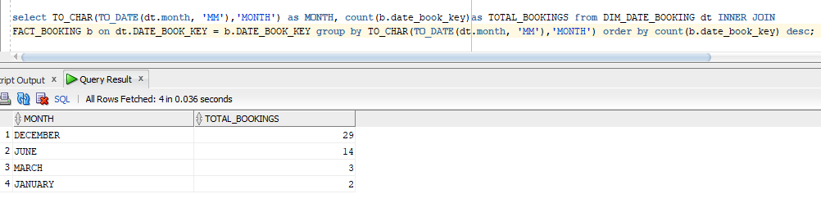
ONLINE Hotel booking PORTAL: Queries
Query 4: Busiest month for the booking in the hotel

Slide 23
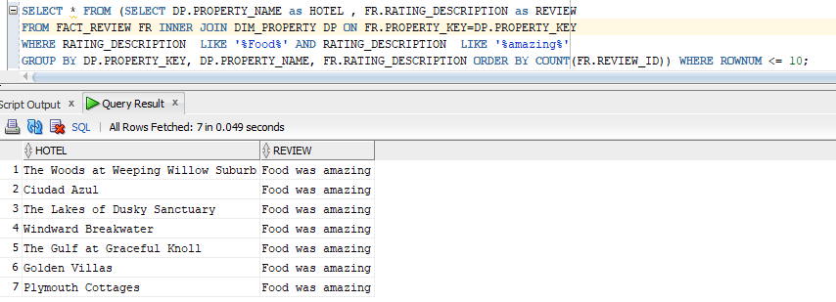
ONLINE Hotel booking PORTAL: Queries
Query 5: Hotels which serves good food on basis of the customers reviews.

Slide 24
Thank You

